Slide 1
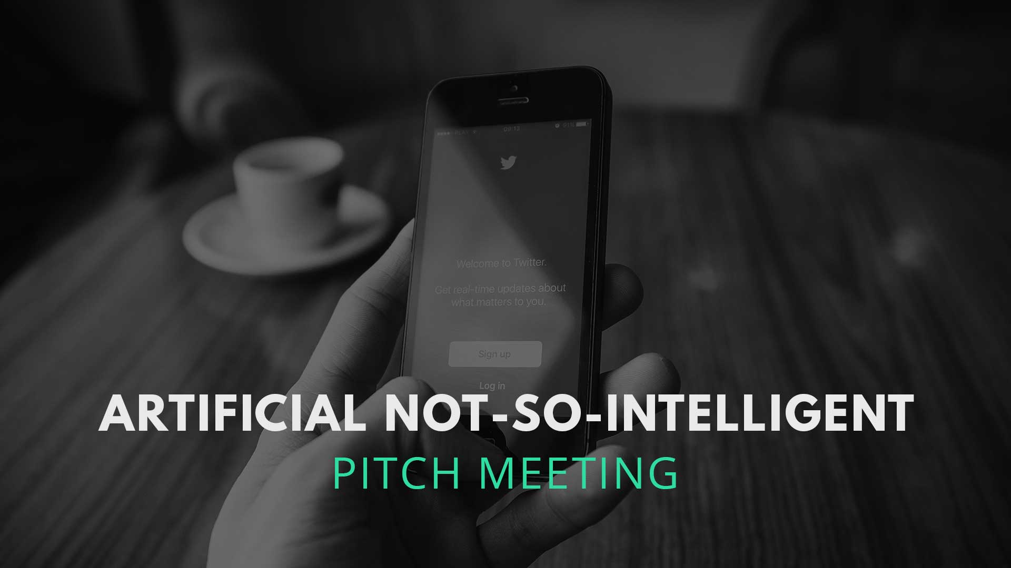
IS434 Social Analytics
Group 1
Done by: Chia Hui Min, Koh Wei De John, Lee Qixian, Lee Weng Ho Mervyn & Ong Ming Hao

Slide 2
HACKATHON
WHAT ARE THE GOALS OF THE PROJECT
Create a WebCrawler to crawl data from Social Media. (Twitter, Facebook, etc.)
Cleanse the data of any bias and improve quality
Prepare data for sentiment analysis to serve various use cases in market sentiment for products and/or predicting sales figures
Leveraging sentiment score to forecast major market movements

Slide 3
THE APPROACH
WHAT WE ARE PLANNING TO DO ( WEBCRAWLER + DATA CLEANING)
I can create a web crawler for twitter + I can do the cleaning. i.e. removal of any biasness, spell checker, remove stop words, etc.
* What to crawl?

Slide 4
THE APPROACH
WHAT WE ARE PLANNING TO DO ( FORECAST MARKETS MOVEMENTS )
Create a sentiment analysis python scripts to run to get the sentiment of a twitter tweet.
Define a strategy of when to buy a financial product, which financial product to buy, how much to buy, etc.
* Worked on sentiment analysis and used a library to do sentiment analysis.

Slide 5
NEXT STEPS
WHAT ARE THE NEXT STEPS FOR THE HACKATHON
What kind of data do we want to analyse. (Market trends, etc.)
What would be the project scope. (Do you want to create a visualisation dashboard, a entire analytics workflow, or just a simple proof of concept via Jupyter notebook)
Obtaining the data to do the analysis
Ways to Analyse market trends; how does social media = predict markets
How do we show the effectiveness of the model?

Slide 6
RESOURCES
[Sentiment Analysis in Python] - https://medium.com/analytics-vidhya/simplifying-social-media-sentiment-analysis-using-vader-in-python-f9e6ec6fc52f
[Spell Checker by the person behind Google Autocorrect] - http://norvig.com/spell-correct.html
[Text Analytics Crash Course] - https://towardsdatascience.com/your-guide-to-natural-language-processing-nlp-48ea2511f6e1
[More Detailed NLP Crash Course] - https://machinelearningmastery.com/crash-course-deep-learning-natural-language-processing/
[A bot that makes money from Donald Trump’s Tweets] - https://techcrunch.com/2017/02/10/trump2cash-lets-you-invest-automatically-whenever-the-president-mentions-a-publicly-traded-company/

